Slide 1

IMAGE CLASSIFICATION USING DEEP CNN
BY: SESNA TOMY
ID: STB03

Slide 2
Problem Statement
Develop a robust image classification model capable of accurately categorizing images into predefined classes based on visual content. Dataset containing images captured from a diverse set of scenes and environments, including natural landscapes and urban settings.
The images are labeled with specific categories, representing different types of scenes or objects. Build and train a machine learning model to classify images into the correct category. The model should be able to generalize well to unseen data and perform efficiently across various environmental conditions.
The dataset consists of a collection of images, each belonging to one of several predefined classes. These classes may include, but are not limited to, buildings, forests, mountains, seas, and streets.

Slide 3
Data Preparation and Cleaning
Used load_data function for loading the images and corresponding labels from two directories (training and testing datasets).
It iterates through each category (folder), reads each image, resizes it, and appends it to the images list along with its corresponding label in the labels list.
The function returns a tuple containing the training and testing data, where each element is a tuple of images and labels.
After loading the data, the training images and labels are shuffled. Shuffling is a common practice to ensure that the model does not learn patterns based on the order of the data.
The pixel values of the images are normalized to a range between 0 and 1 by dividing them by 255.0. Normalization helps in training neural networks by ensuring that the input features are within a similar scale, which can improve convergence during training.

Slide 4
Model Creation
Created a sequential model with the following layers:
Two convolutional layers (Conv2D) with ReLU activation.
Two max-pooling layers (MaxPooling2D) to down-sample the spatial dimensions.
A flattening layer to convert the 2D output to a 1D tensor.
A dense layer with 128 neurons and ReLU activation.
The output layer with 6 neurons (assuming you have 6 classes) and softmax activation for multi-class classification.
The model is compiled with the Adam optimizer, sparse categorical cross entropy loss (suitable for integer-encoded labels), and accuracy as the evaluation metric.
The fit method trains the model on the provided training data (train_images and train_labels) for a specified number of epochs (10 in this case). It also uses a batch size of 128 and includes a validation split of 40% to monitor validation performance during training.

Slide 5
Transfer Learning
Transfer learning is a powerful paradigm in machine learning, especially in the context of deep neural networks. It involves leveraging pre-trained models on large datasets for a specific task and adapting them to solve a new, related problem with limited labeled data.
By transferring knowledge gained from one domain to another, transfer learning accelerates model training, enhances performance, and allows for effective solutions in scenarios where obtaining extensive labeled data is challenging.
Used the pre-trained VGG16 model from TensorFlow/Keras, excluding the top (fully connected) layers, as indicated by include_top=False
Create a new model by adding your own top layers on top of the pre-trained VGG16 base. This includes flattening the output, adding dense layers with ReLU activation, and a final dense layer with softmax activation for classification.
Compile the model using the Adam optimizer, sparse categorical cross entropy loss, and accuracy as the evaluation metric.
The model is trained using the fit method on the training data with validation data provided. The training runs for 10 epochs with a batch size of 128.

Slide 6
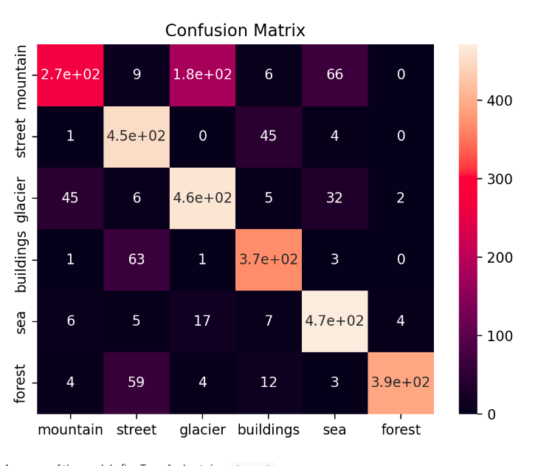
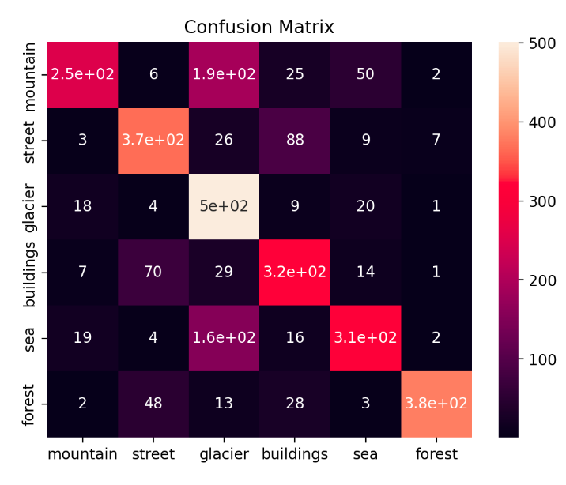
Model Evaluation
The classifier has trouble with 2 kinds of images. It has trouble with street and buildings. It can be understandable as there are buildings in the street. It has also trouble with sea, glacier and mountain as well. However, it can detects forest very accurately! The accuracy of the model has improved after the transfer learning.

Slide 7
Conclusion
Our project successfully deployed a transfer learning approach, utilizing a pre-trained VGG16 convolutional neural network, to develop an image classification model. Trained on the diverse Intel Image Classification dataset, the model demonstrated high accuracy in categorizing images across six distinct categories. With applications spanning environmental monitoring, tourism recommendations, and disaster response, our work underscores the value of leveraging pre-trained models for efficiently addressing real-world challenges.

Slide 8
THANK YOU

